Slide 1





Your trusted global Databricks Champions
Notes:
End-to-end data, analytics & AI delivery on Databricks — Forward Deployed Engineers embedded with your team, from lakehouse foundations to production GenAI.

Slide 2


People-led delivery
A bit about
Advancing Analytics
100+ specialists across data strategy, engineering and AI.
11 Databricks Champions and 2 Databricks MVPs on staff.
Community-led — we run the meetups, we write the blogs, we teach the courses.

Slide 3



Speaker Introduction – Ash Warren
I help people with their Analytics Engineering, Databricks AI/BI & Genie problems
My background is as a Power BI developer. In recent years, I’ve shifted to being Databricks focused & now spend most of my time helping enterprise clients with data modelling, analytics engineering and implementing & governing their analytical products
Regular community speaker – this is my 10th session this year
Spoke at Data+AI Summit 2026 – Why it’s time to take AI/BI seriously
Co-organise user groups – I’m passionate about giving back to the community
/aw2571

Slide 4
Genie Use-Case
A lot of our customers
have a similar background to me
1
2
3
Established Power BI skillset
Now powered by a Databricks
Strong use-case for Genie
Power BI used for visualisation for years but is becoming a bottleneck for delivering value quickly
Their lakehouse in Databricks is generating considerable value and enabling their engineers to move fast
And they now want their analytics to match that pace & leverage all the work that has gone into the platform
Ultimately, Genie enables users to interact with their data themselves and answer their exact questions on the fly, rather than having to wait on the development of a generic report

Slide 5
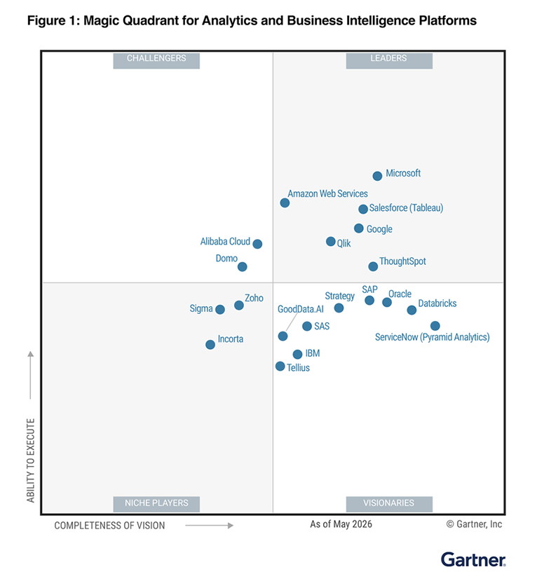
Industry Shift
The industry is shifting towards tools like Genie
Look at the Gartner Magic Quadrants for Analytics and Business Intelligence 2026.
ANALYSIS
The vision axis is shifting right
Compared to last year, the typical leaders have all seen their position move left despite all of them improving as products. The vision axis is being pushed right by a new wave of analytics tooling, spearheaded by Databricks Genie
The strongest ever debut
Databricks made the strongest ever debut – one of only two ever to land outside the Niche Players. This is mostly driven by the vision of Genie
Time to kick on
Most of the exciting Genie announcements that power this vision, such as Ontology, aren’t GA yet. When they are, expect Databricks’ ability to execute to rise

Slide 6
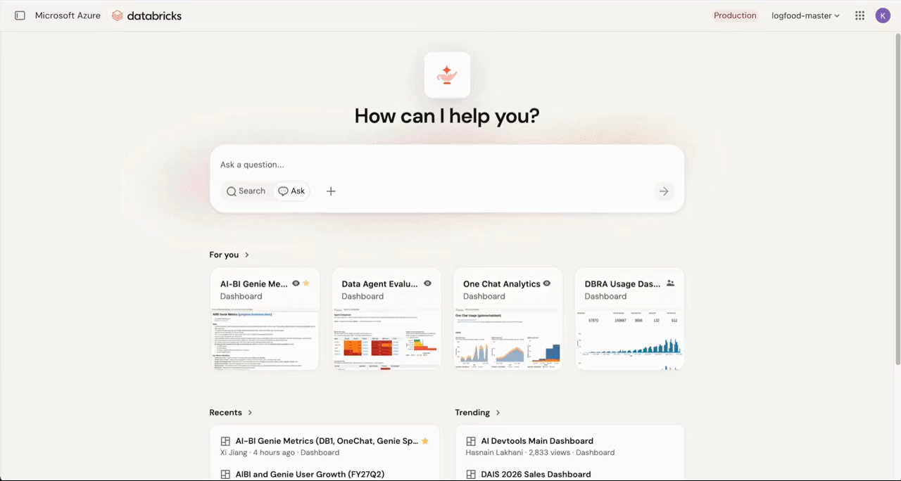

Slide 7
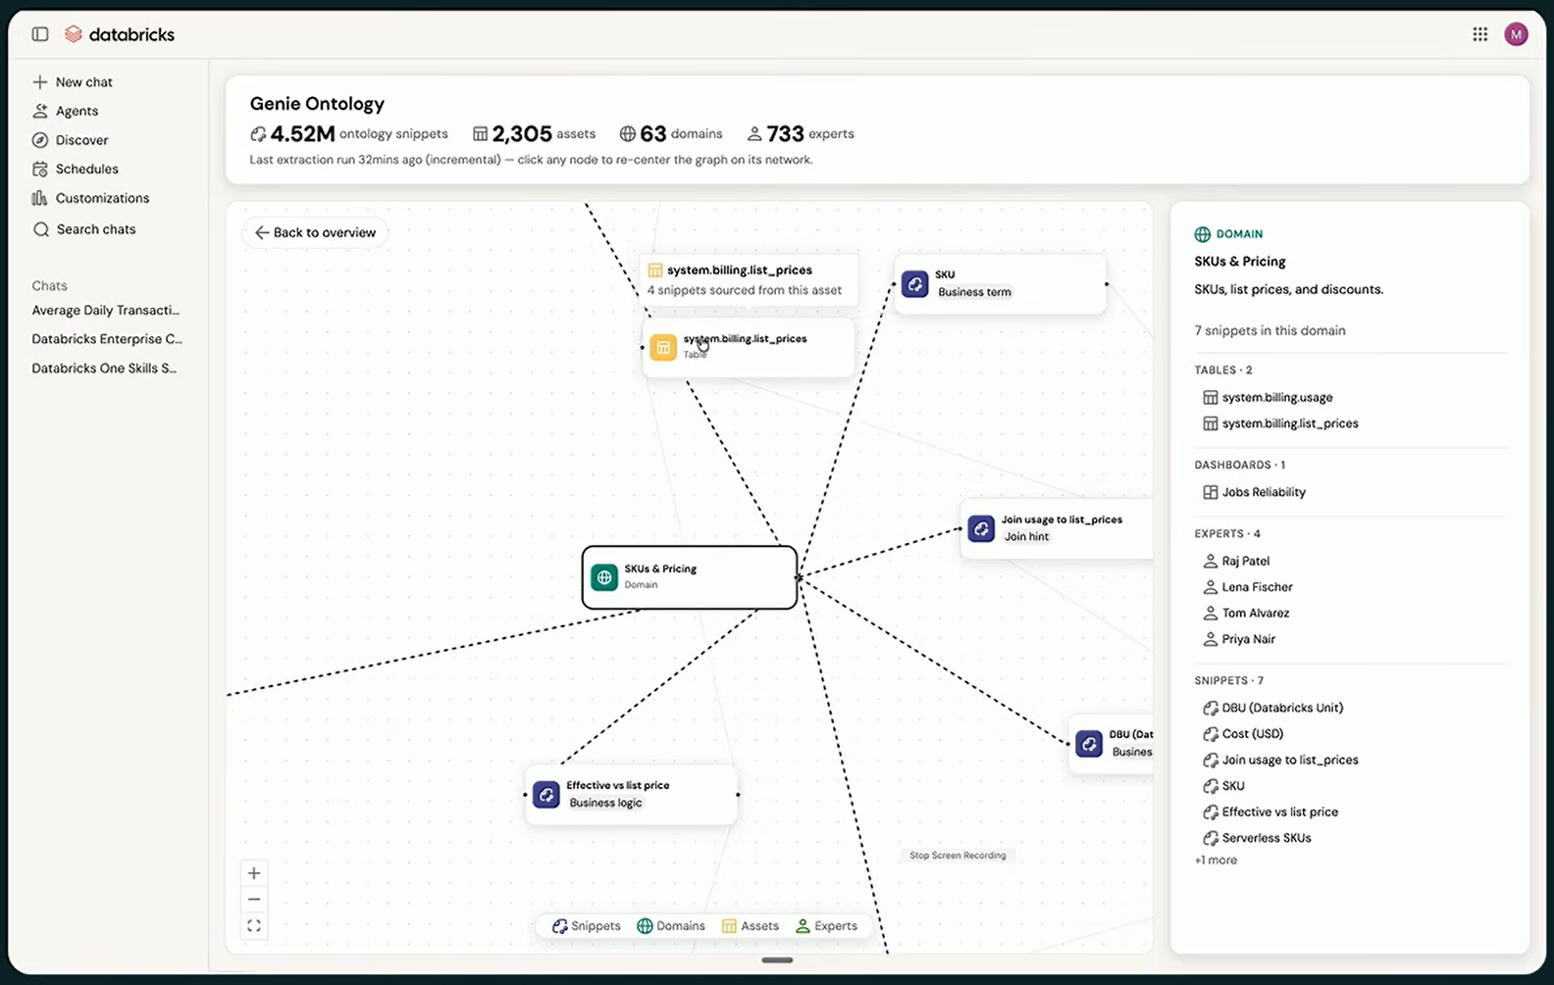
Genie Ontology might know more about your business than you do
Ontology scans all the entities within your Databricks estate as well as any connected apps (such as Teams, Slack, Google Drive, Sharepoint, etc.)
From this it creates a Knowledge Graph of your domains, business terms, metric definitions, etc & all the relationships between them
This then enables Genie to answer questions with context of your business

Slide 8
Genie Ontology makes Governance more important than ever
A well-governed Databricks estate, will help Genie produce better answers

Slide 9
The challenges our clients face with Genie are mostly People and Process related
The technology is already more capable than their people and processes can currently handle. What they are lacking is the Governance strategy sitting behind Genie to make it successful

Slide 10
If your users don’t trust Genie,
then they won’t use it
The best way to set yourself up for success with Genie is to define your governance strategy upfront. A clear approach to governance, will help you win trust

Slide 11
Governance
Organisations that can answer these questions, are the ones that are going to get success out of Genie
1
2
3
Accountability
Responsibility
Enablement
Who owns Genie and is willing to take accountability for both it’s success and failures within your organization?
Who is taking responsibility for ensuring the accuracy of Genie within the context of your business?
How are you going to enable users to get the most out of Genie, and support them when issues arise?

Slide 12
Please add me on LinkedIn!
I post tips & tricks every Monday
/aw2571
Insight-driven. Experience-led. Always curious.
Whether you're rethinking your data platform or scaling your next GenAI breakthrough, we'd love to talk.
Get in touch
→
advancinganalytics.co.uk

